Slide 1
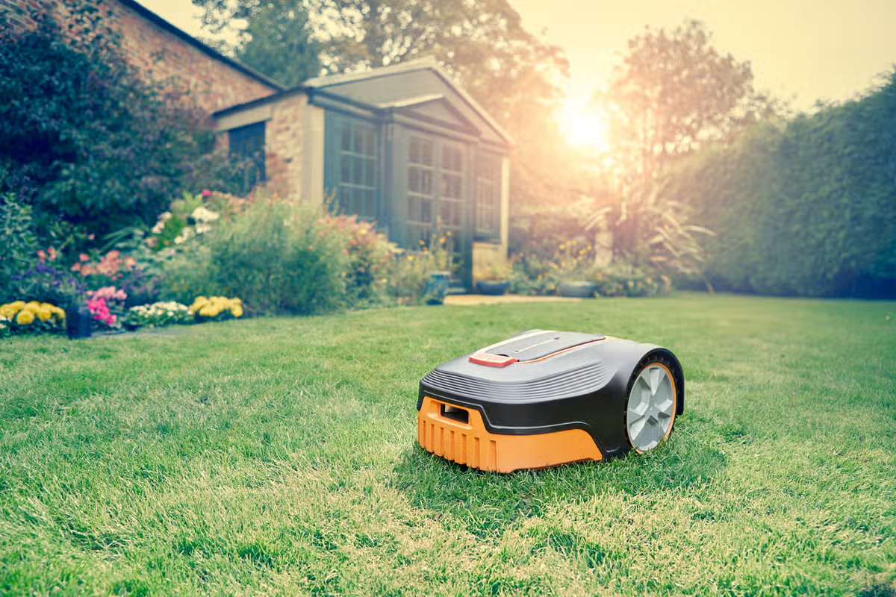




21AIE213 - Robotic Operating Systems & Robot Simulation
Lawn Mower Robots
D. Mohammad Abdulla - BL.EN.U4AIE21044
G .Tej Deep Reddy - BL.EN.U4AIE21048
G. Mukesh venkata Sai - BL.EN.U4AIE21050

Slide 2
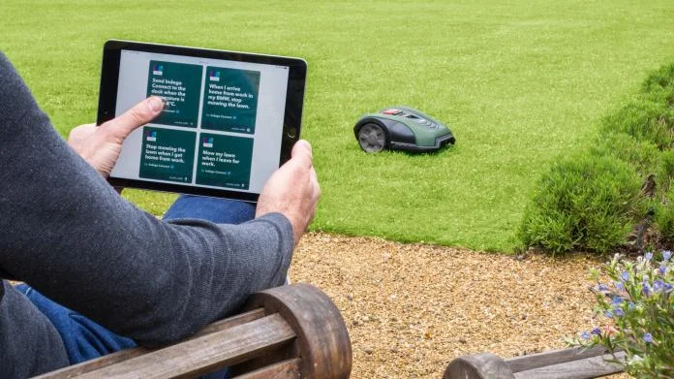


Problem Statement
Design and implement a lawn mowing robot using a custom-built differential drive robot.
The robot should traverse all the locations of the environment, the boundaries of the environment should be exclusively given as inputs in terms of boundary coordination, and also assume some static objects placed in the environment. The total number of laps should be taken as input.

Slide 3
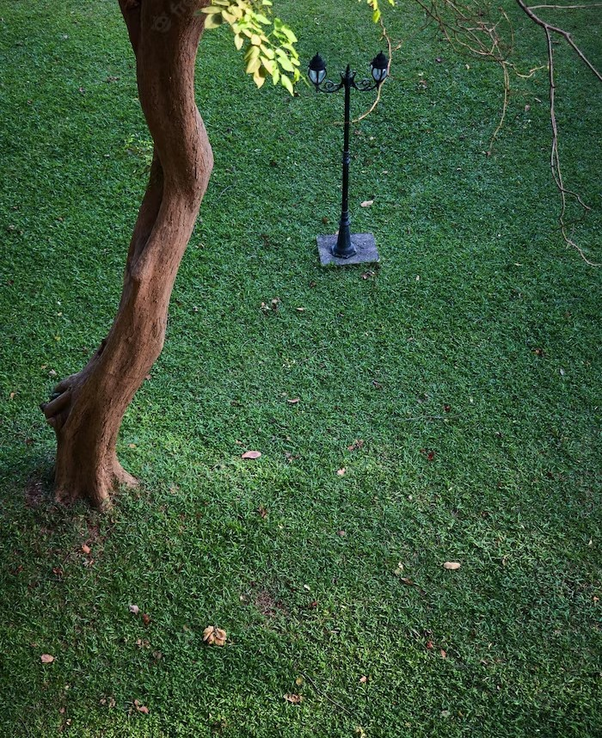
Introduction
Lawn mower robots are the latest technology in lawn care.
These robots are designed to mow lawns automatically, freeing up time for homeowners and reducing labor costs for businesses.
The beneﬁts of these robots are numerous and they are quickly becoming a popular choice for lawn care maintenance.

Slide 4
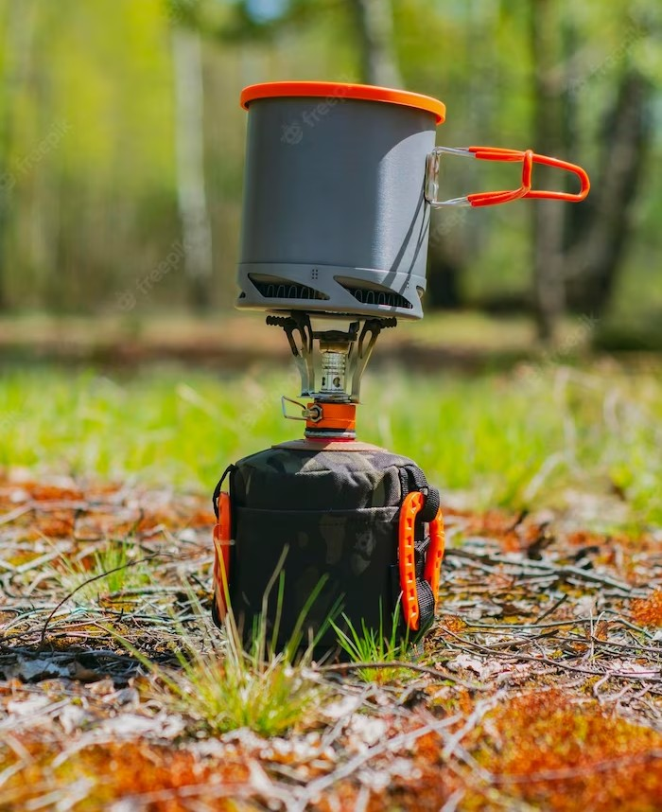
How Lawn Mower Robots Work?
Lawn mower robots use GPS navigation and mapping technology to mow lawns.
They are programmed to follow a speciﬁc pattern and avoid obstacles, ensuring a thorough and even cut.
Most models are powered by rechargeable batteries, making them environmentally friendly.
Some models can even be controlled through a smartphone app.

Slide 5

Benefits for Home Owners
Lawn mower robots offer many beneﬁts for homeowners.
They save time and effort, as the robots do the work automatically.
They also provide a more even cut than traditional mowers, resulting in a healthier lawn.
Additionally, they are quieter than traditional mowers and can operate at any time of day.

Slide 6
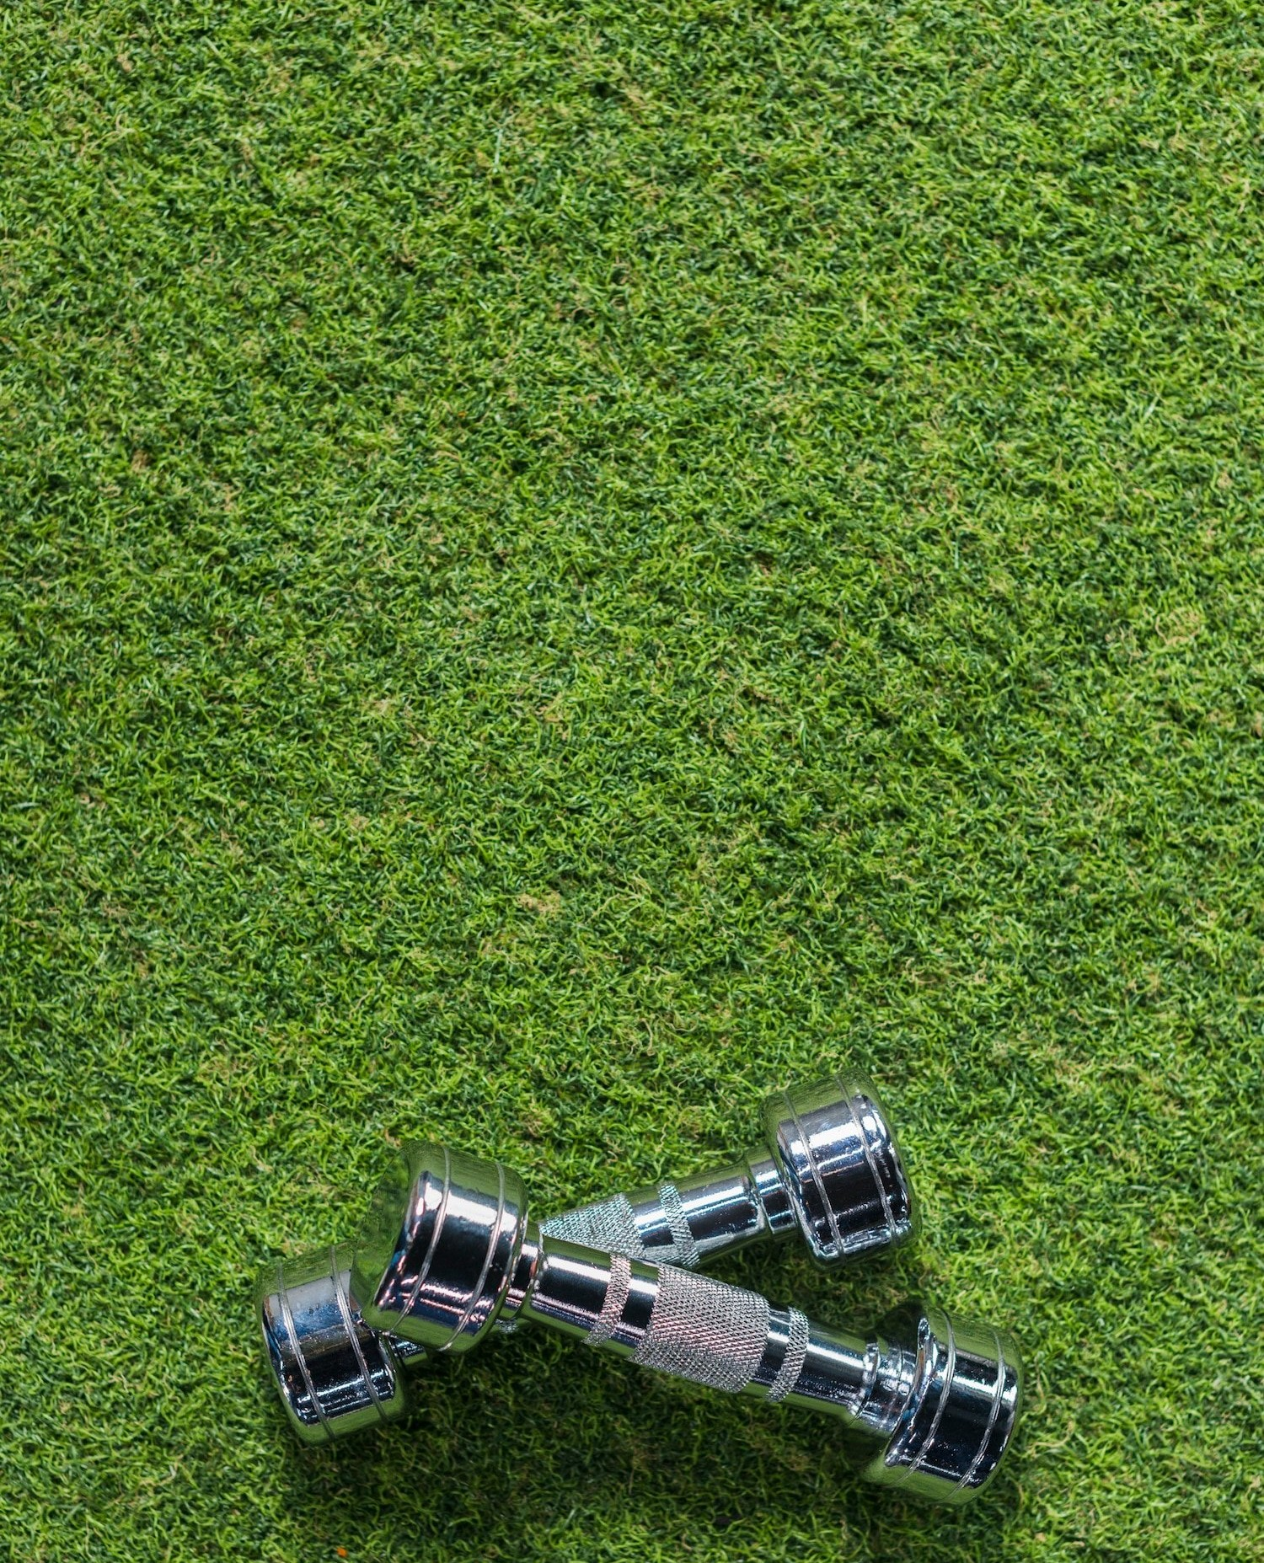
Benefit for Businesses
Lawn mower robots are also a great option for businesses.
They reduce labor costs, as they require minimal supervision. They also operate quietly, allowing businesses to operate during business hours without disturbing customers.
Additionally, they can mow large areas quickly and efﬁciently, making them ideal for golf courses, parks, and other large spaces.

Slide 7
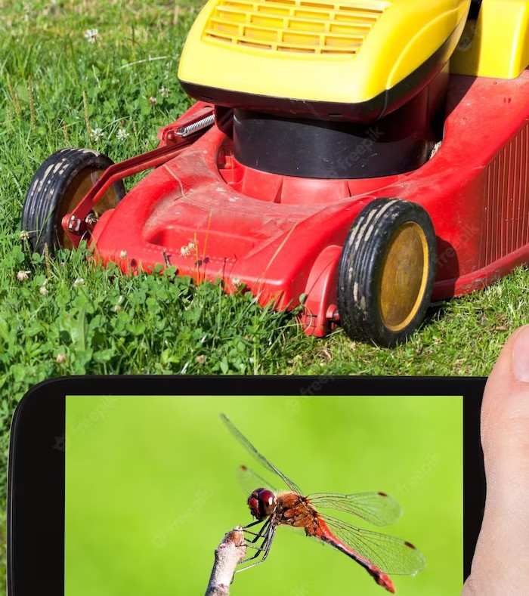
Safety Features
Lawn mower robots are equipped with many safety features.
They are designed to automatically shut off if they encounter an obstacle or are picked up.
They also have sensors that detect pets and humans, ensuring they do not cause injury. Additionally they are equipped with anti-theft features, making them difﬁcult to steal.

Slide 8
Conclusion
Lawn mower robots are the future of lawn care.
They offer numerous beneﬁts for both homeowners and businesses.
With their advanced technology and safety features, they are an efﬁcient and safe option for lawn maintenance.
Investing in a lawn mower robot is a smart choice for anyone looking to save time and money while maintaining a beautiful lawn.

Slide 9


Code :

Slide 10


Slide 11

THANK YOU
Presented by,
Team D-19
D. Mohammad Abdullah – BL.EN.U4AIE21044
G. Tejdeep Reddy – BL.EN.U4AIE21048
G. Mukesh Venkata Sai – BL.EN.U4AIE21050

